Slide 1
SQL Server Security Basics
Author: Uwe Ricken db Berater GmbH

Slide 2











Slide 3

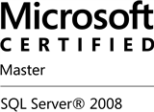


Uwe Ricken db Berater GmbH
I am working with IT-systems since early 1990's and with the main focus on Microsoft SQL Server since version 6.0. I started with development of database applications in 1998 with a professional CRM-System based on Microsoft products (Microsoft Office and Microsoft SQL Server).
Since 2008 I'm focused exclusively on Microsoft SQL Server and since 2008 I'm working in 3rd level support teams for banks, insurances and global industries.
Since May 2013 I'm a Microsoft Certified Master: SQL Server 2008 which was an amazing way into the depth of Microsoft SQL Server.
In July 2013 I have been awarded with the MVP Award for Microsoft SQL Server.
www: http://www.db-berater.de
email: uwe.ricken@db-berater.de
blog: http://www.sqlmaster.de
twitter: @dbberater
xing: http://www.xing.com/profile/Uwe_Ricken

Slide 4
Agenda
Gain access to the "honorable house"
Logins
Mixed Authentication vs. Windows Authentication
Possible permissions in the "honorable house"
Server Roles
Gain access to the apartment
Database Users
Owners of apartment vs. roommate
Setting up the apartment
Planning the possible rooms in the apartment (Schemata)
Permissions in the rooms

Slide 5
Nomenclature
Microsoft SQL Server Instance: apartment house
Database in SQL Server Instance: apartment
Schema in a Datenbank: room
Tables / Views / …: Inventory (furniture, etc.)
Owner: sysadmin
Authorized access: Login
Renter: database user

Slide 6
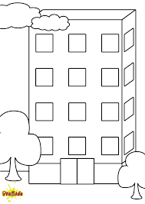
Das ehrenwerte Haus (Server)
A Microsoft SQL Server instance is like a home with few or many homes
If you want to go to the house, you need a key
Access to the house will only be given to persons with a valid keyAusgestellt von einer Behörde (Windows Konto)
Issued by the owner of the house (SQL account)
NB-LENOVO-I\SQL_2016

Slide 7

Key handover by identity card
Donald owns a BPA and would like to enter the house.
Donald is clearly identifiable by his id number.
Donald only needs the key to the hallway.
identity card
Donald Duck
Entengasse 10
12345 Entenhausen
0x010500000000000515000000F90DD5F…

Slide 8

Create a login (Windows)
Donald is a member of the domain.
Donald is clearly identified by his SID.
Donald needs a login to access Microsoft SQL Servers.
Identity card
Donald Duck
Entengasse 10
12345 Entenhausen
0x010500000000000515000000F90DD5F…

Slide 9

Key handover by owner
Daisy does not own a id card.
Since Daisy is not uniquely identifiable, the owner of the house must create an access for Daisy himself.
This automatically gives Daisy a key to access the house!
Arobic-Club „Lame duck“!
Daisy Duck
Entengasse 12
12345 Entenhausen
0xB8BF828021847B48ADFA62FD6B40E78E

Slide 10
Key handover by owner
For Daisy, an account is created in SQL Server.
This account is valid only for SQL Server
Arobic-Club Lahme Ente!
Daisy Duck
Entengasse 12
12345 Entenhausen
0xB8BF828021847B48ADFA62FD6B40E78E

Slide 11
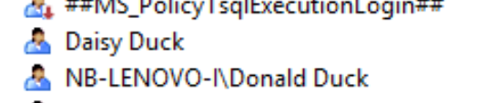
Access to the honorable house
KEY
NB-LENOVO-I\SQL_2016

Slide 12
Access to the apartment
Each database in a SQL Server is a separate apartment
Only because a key exists for the house, I can not enter every apartment!
To enter an apartment, I need a second key

Slide 13
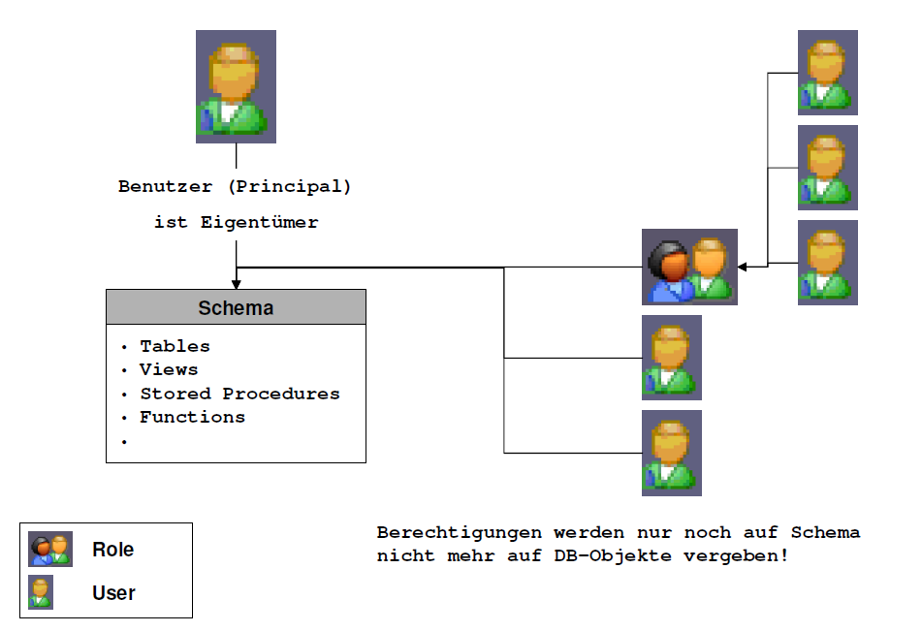
Schemata
A scheme is the room of an apartment!
A schema is a container for objects.
A single schema may contain objects owned by different users.

Slide 14
So, get out now! House is being demolished
Thank you very much for your attention
Uwe Ricken
db Berater GmbH

Slide 15
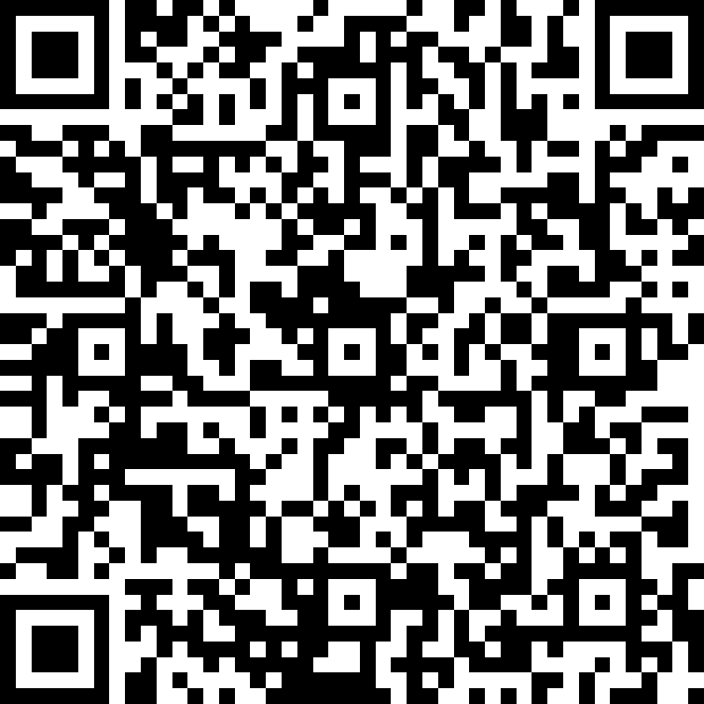
Session Feedback Day 2 (not optional!)
http://bit.ly/DataGrillen2019Day2

